Slide 1


Slide 2
802.1X Deployment with SU1X
By Gareth Ayres

Slide 3
Agenda
1.0 Quick Introduction
2.0 Wireless and Eduroam at Swansea
3.0 The Problems
4.0 The Solutions
5.0 Our solution: SU1X
6.0 SU1X Demo?

Slide 4
1.0 Quick Introduction
Gareth Ayres
  Wireless Network Officer, Swansea University
    Development of wireless network and other networking stuff
    Part of the original LIN JRS trials
    Member supplicant group
    Member 802.1x SIG group
  PhD Student (unrelated)
  FIFA Assistant Referee (sorry!)

Slide 5

2.0 Wireless at Swansea: 2004
2004-2005
4 RoamNode Servers (VPN & PPPOE)
250 Autonomous access points
~800 unique users / day

Slide 6
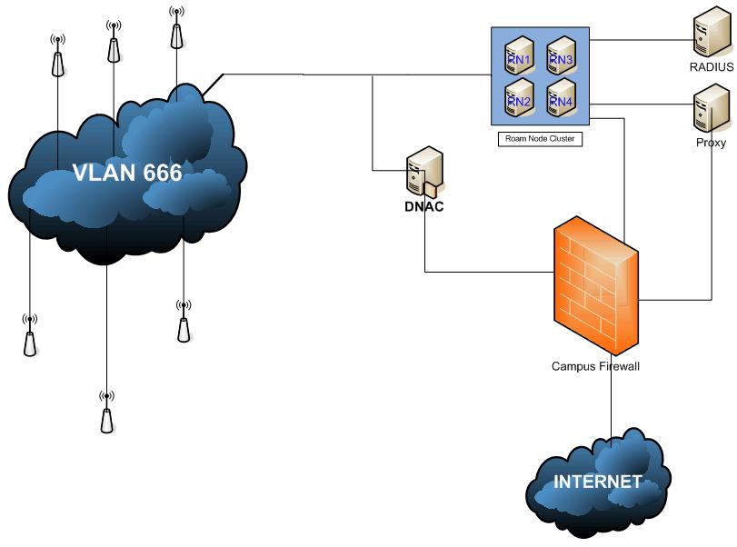
2.0 Wireless at Swansea: 2004

Slide 7
2.0 Wireless at Swansea: 2004

Slide 8

2.1 Wireless at Swansea: 2007
2007-2008
10 RoamNode Servers (VPN servers)
700 Autonomous access points
Setup Wireless Network
~2300 unique users / day

Slide 9
2.1 Wireless at Swansea: 2007

Slide 10
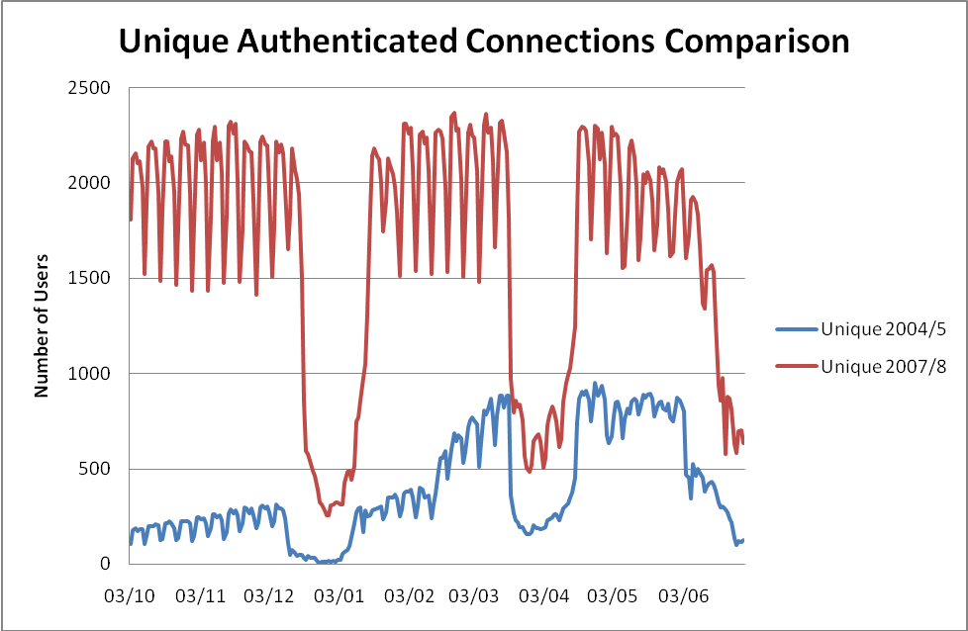
2.1 Wireless at Swansea: 2007

Slide 11
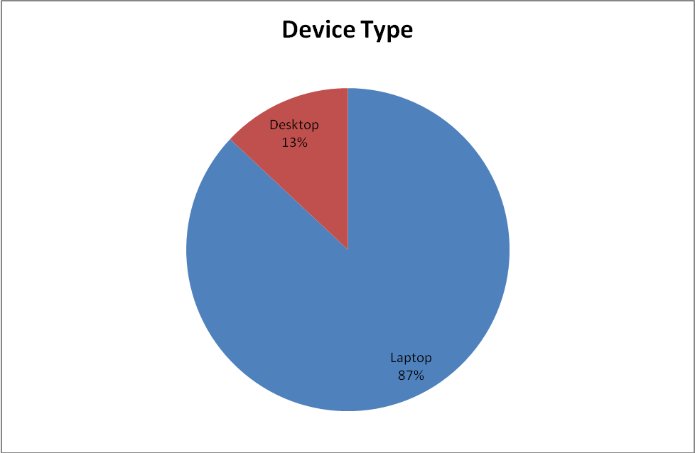
2.1 Wireless at Swansea: 2007

Slide 12
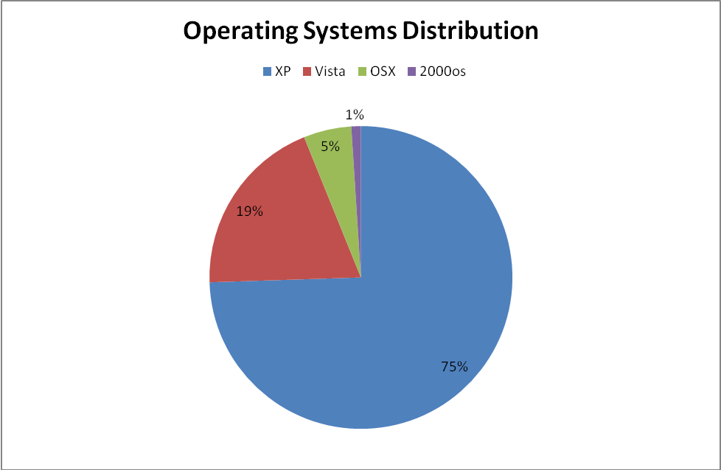
2.1 Wireless at Swansea: 2007

Slide 13

2.2 Wireless at Swansea: 2009
2009-2010
0 RoamNode Servers
~850 Lightweight access points
4 Cisco WiSM’s
~3000 unique users / day
1 WPA eduroam SSID, 1 open setup SSID

Slide 14
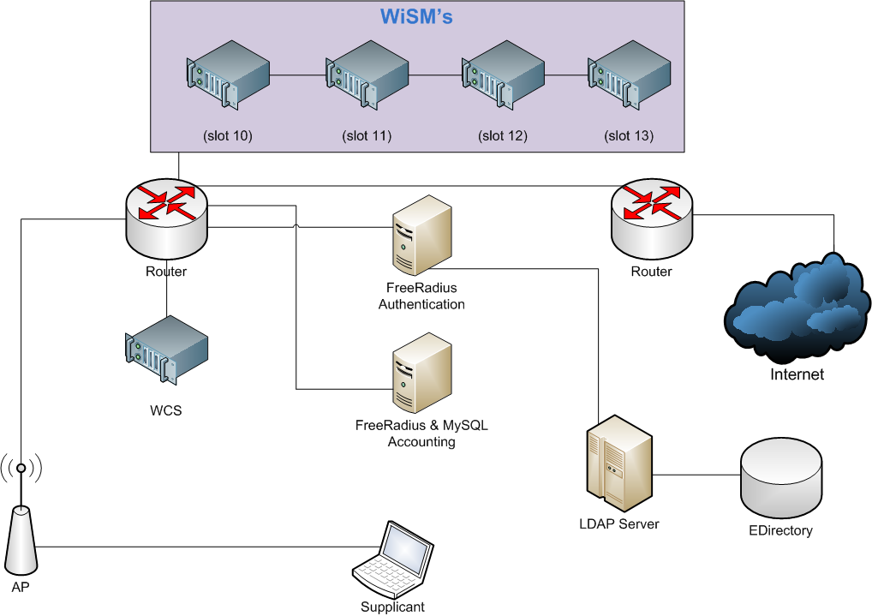
2.2 Wireless at Swansea: 2009

Slide 15
2.2 Wireless at Swansea: 2009

Slide 16
2.2 Wireless at Swansea: 2009

Slide 17
2.2 Wireless at Swansea: 2009

Slide 18
2.2 Wireless at Swansea: 2009

Slide 19
3.0 The Problems
Problems with a 802.1X Wireless Networks:
Design Problems (Initial problem)
Support Problems (Everlasting problem)

Slide 20
3.1 The Problems: Design
Is 802.1X wireless complicated?
WPA or WPA2 + EAP (PEAP [with EAP-MS-CHAPv2 or EAP-TLS] or TTLS [with MSCHAPv2 or TLS or PAP)) with certificates + back end authentication (LDAP or AD or Novel e-directory) + RADIUS (FreeRadius or Cisco ACS or Radiator or IAS) * Different client implementations = Confusion
Yes it is...

Slide 21
3.1 The Problems: Design
But... Its not that complicated when you get used to the acronyms and understand the fundamentals.
Design directly affects future support needs.
Design... Beyond the scope of this presentation
Swansea = WPA/WPA2+PEAP/TTLS+FreeRadius+LDAP/e-dir

Slide 22
3.3 The Problem: Support
This time, it really is Microsoft's fault!
Well, all OS developers, Cisco and Juniper’s fault. A little bit...
Supplicant is the biggest support issue
    Microsoft = PEAP = 69% of clients
    OSX = PEAP or TTLS = 7%
    Linux = PEAP or TTLS = 7%

Slide 23
4.0 The Solutions: Supplicants
Supplicants:
  Microsoft = free with OS
  OSX = free with OS
  WPA_Supplicant (Linux) = Open Source
  Cisco / AEGIS = Closed shop
  Juniper / Odyssey = $$$
  SecureW2 = $$$

Slide 24
4.1 The Solutions: Supplicants
IEEE 802.1X = Open Architecture
Any EAP type should work
Supplicant should be free, easily configurable and deployable
Big companies owning supplicants with their own agendas
OS developers should provide good supplicants.
Shouldn't have to pay to configure OS supplicants

Slide 25

4.2 The Solutions: OpenSEA
OpenSEA – JANET UK Supplicant Group
Were hoping to use Open1X for all OS’s in 2009.
OpenSEA not ready.
Either pay for XpressConnect or SecureW2 or deal with native OS supplicants.

Slide 26
4.3 The Solutions: Manual Configuration
Faced with Manual Configuration:
  4000 users need to be set up in a few days
  Takes ~4 mins for IT Staff to do manual configuration
  Too complicated for users
  4000 * 4 = 16000 mins = 266 hours = tired IT Support Staff

Slide 27

5.0 Our Solution: SU1X
Windows XP (SP3), Vista and Win7 Supplicants are OK.
    Some issues, but not show stopping.
    Configuration and certificate distribution difficult
  WLANAPI allows for wireless control and configuration
  Deployed from open setup SSID upon registration
  SU1X = Tool that uses wlanapi to configure Microsoft supplicants

Slide 28
5.1 Our Solution: SU1X Features
SU1X Features:
Automation of configuration of a PEAP wireless connection
XP(SP3),Vita and Win 7
EAP credentials without additional user interaction
Installation of a certificate (silent)
Checks for WPA2 compatibility
Third party supplicant check
SSID removal and priority

Slide 29
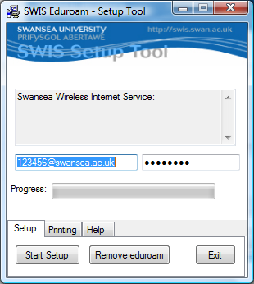
5.1 Our Solution: SU1X Features

Slide 30
5.2 Our Solution: SU1X Support
Additional Features:
Support tab: Checks: adapter, wzc service, profile presence, IP
Outputs check results to user with tooltip bubble
and/or to file
Printer tab to add/remove networked printer
    Wireless Printing = Income

Slide 31
5.3 Our Solution: SU1X Future
Possible Future Features:
Remove capture tool and use config file only
Send problem report emails
LDAP credential checks via HTTPS to PHP

Slide 32
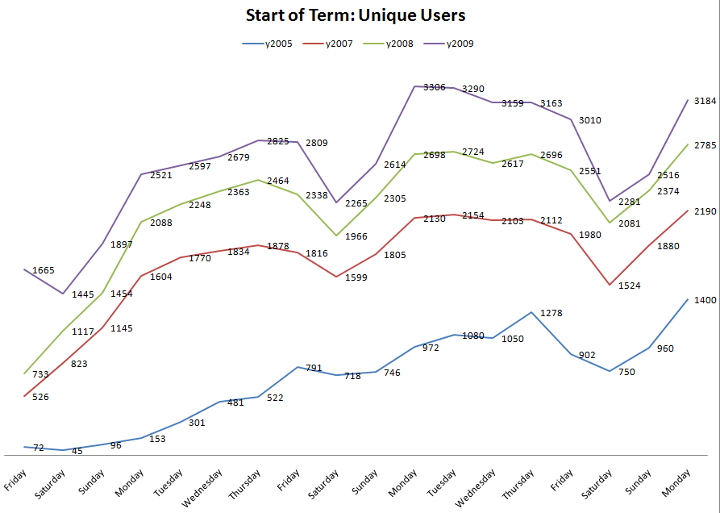
5.4 Our Solution: Did it work?

Slide 33
5.6 Our Solution: JANET UK
    In collaboration with JANET UK and Loughborough
    Grateful for help with certificate installation, testing and documentation from Loughborough
    SU1X is Open Source
    http://su1x.sourceforge.net/
    http://www.ja.net/services/authentication-and-authorisation/janet-roaming/su1x.html

Slide 34
6.0 Demo?
Demo or Screen Shots?

Slide 35
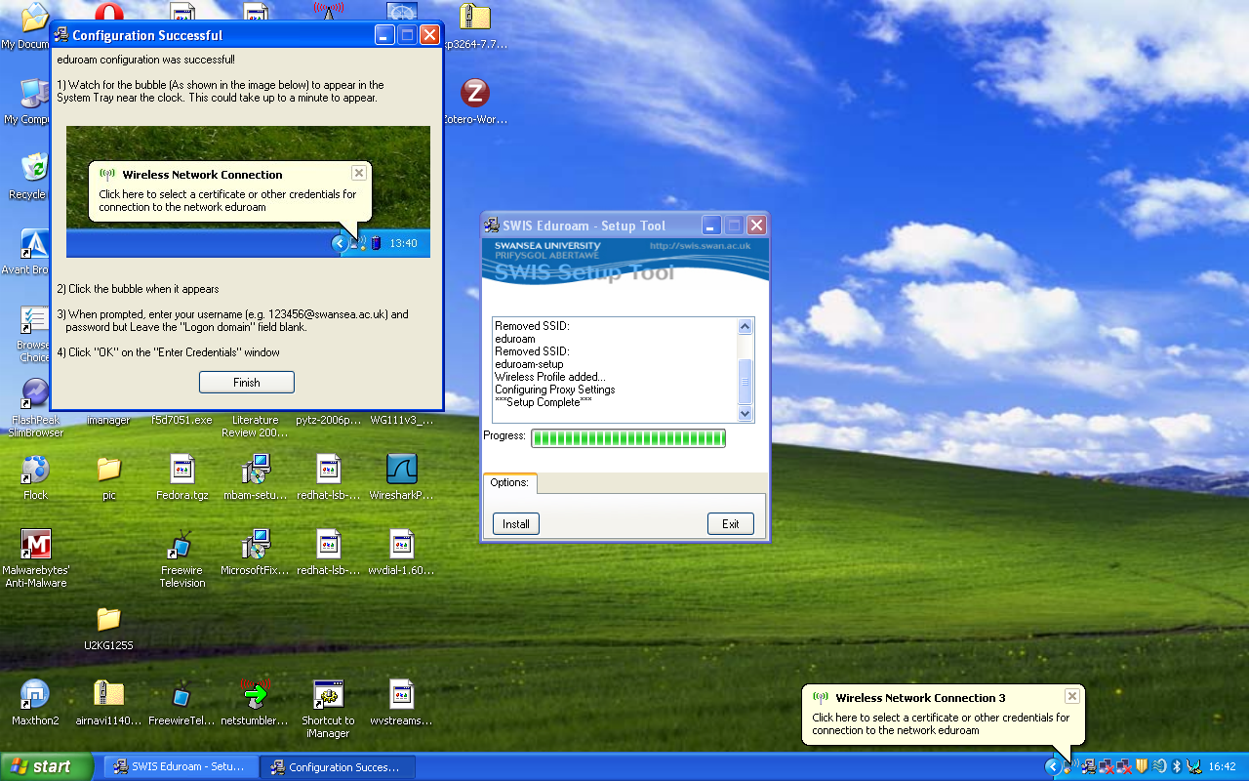
SU1X - Setup Tool

Slide 36
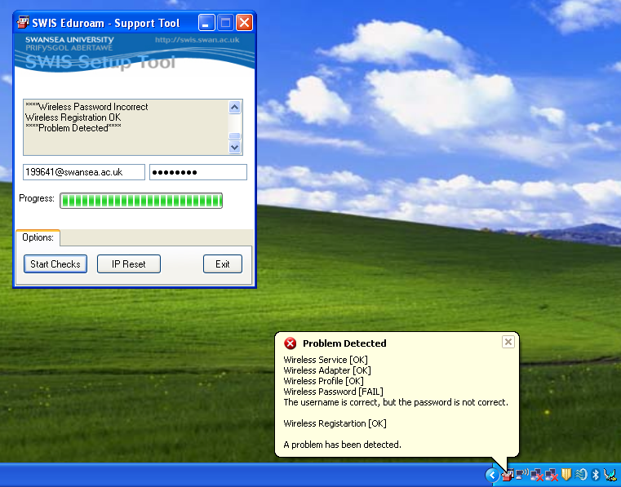
SU1X - Support Tool

Slide 37
Thank You – Any Questions?
Gareth Ayres
g.j.ayres@swansea.ac.uk

